Slide 1
Career Resources
Get a head start on your career path through self exploration!

Slide 2
Introduction
It’s never too early to begin thinking about what career you’d like to pursue after high school. By exploring now, you can gain valuable information that will help this big decision seem easier. It’s important to find a career that fits your personality, strengths and life goals.
By now, you should have completed some (if not all) of the personality assessments located on Naviance. If you haven’t done so already, log-in to Naviance with the following link-
https://student.naviance.com/GHS304
Once you have completed a minimum of 2-3 surveys…move through the PowerPoint and explore the resources we have to offer. Have fun! This is an exciting time ☺

Slide 3
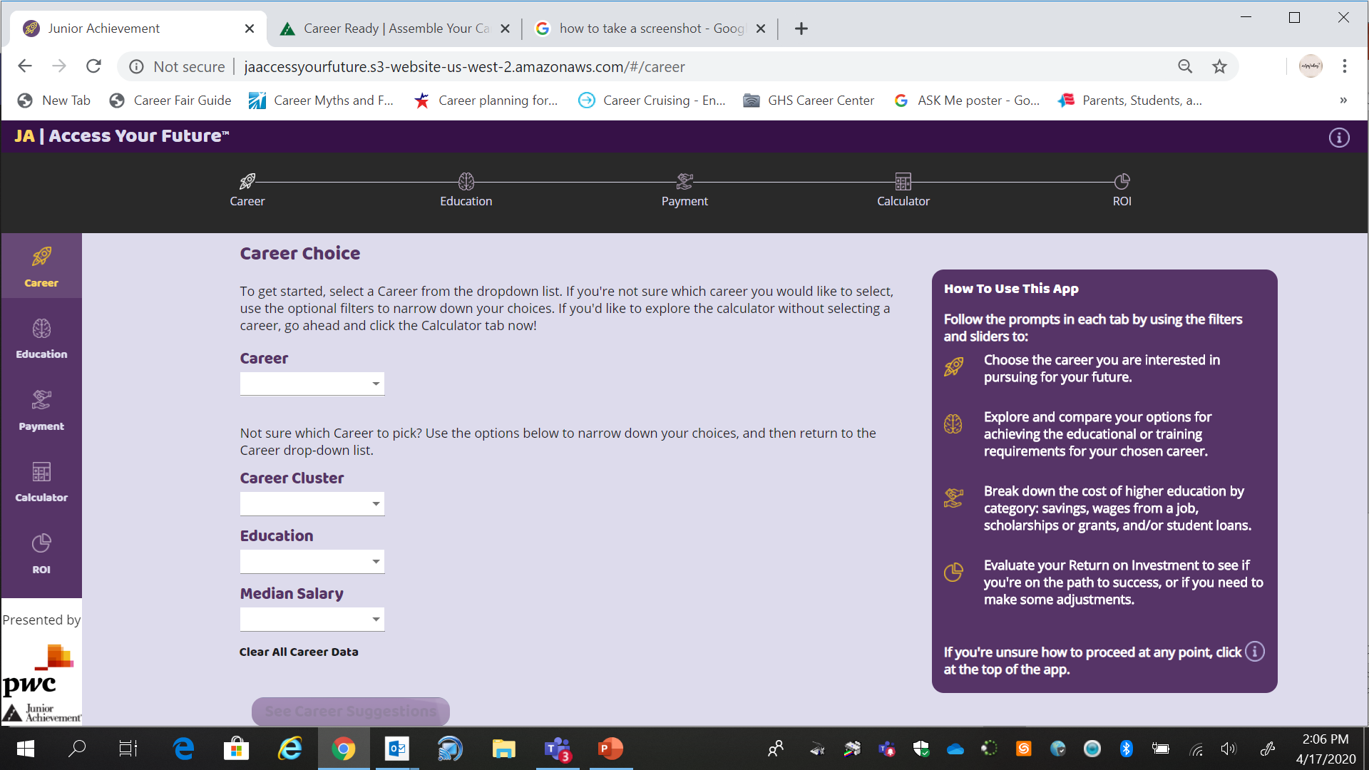
Access Your Future
Further explore what your career of choice will cost for education and long-term advantages/resources.
http://jaaccessyourfuture.s3-website-us-west-2.amazonaws.com/#/career

Slide 4
Focus on Your Future
The following workbook focuses on how to prepare for a job, what to look for and other tools that will help you navigate the process. Double click on the PDF Icon to get started.

Slide 5
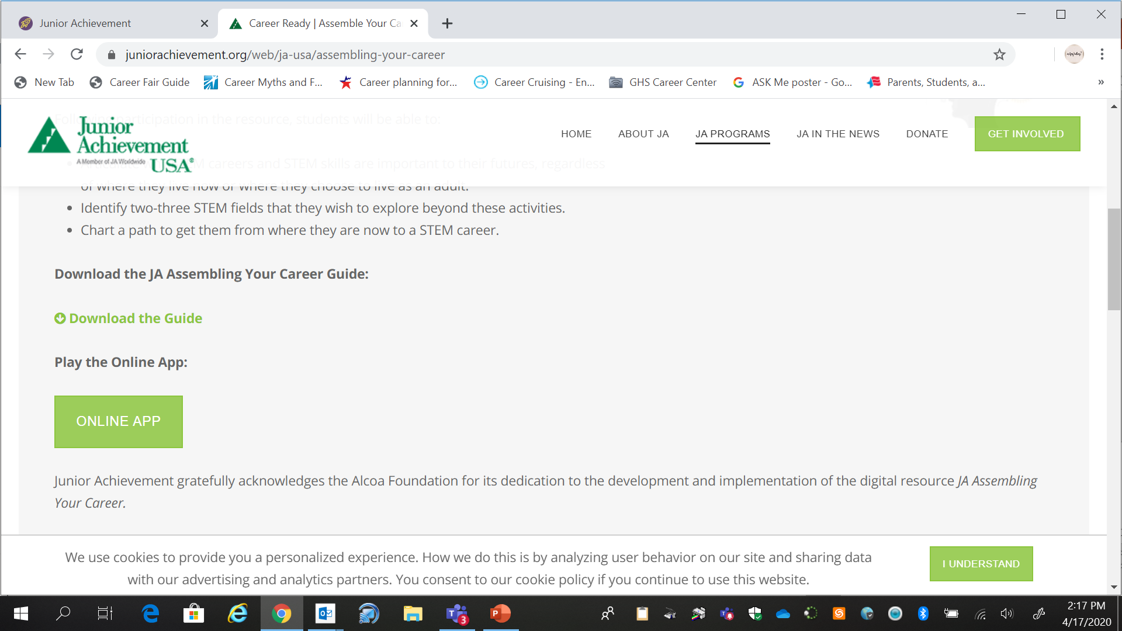
Assemble Your Career STEM Resource
Click on the link below and then scroll down. Click on the green “Online App” logo. Have fun playing around and exploring careers in STEM.
https://www.juniorachievement.org/web/ja-usa/assembling-your-career

